Slide 1

READIBILITY OF FONTS
Team Jaguar:
Sveva Battisti, Raheleh Soltani, Aishwarya Chaudhari
Stuttgart University | 2024

Slide 2
1
OBJECTIVE AND RESEARCH QUESTION
Objective of this experiment was to investigates the impact of one (or more) properties that fonts have on readability.
RESEARCH QUESTION
The aspect that we decided to investigate is the CASE TYPE (lowercase and uppercase)
Are there any differences in eye-movement patterns between uppercase and lowercase text?
Team Jaguar | 2024

Slide 3
2
LITERATURE REVIEW
Some of the closest studies to our purpose (eye movements in the reading of sentences presented in lower compared to upper case text) in design and goal are as follows:
1
Tinker and Paterson (1939) --> Tinker and Paterson used a
photographic technique to record eye movements whilst participants read paragraphs of text in either lower or upper case
Team Jaguar | 2024
2
White, S. J., & Liversedge, S. P. (2006) --> The very first study that provides a first unconfounded test of whether the visual distinctiveness or familiarity of upper, compared to lower, case text influences eye movement control in reading.

Slide 4
3
LITERATURE REVIEW
Tinker and Paterson (1939)
White & Liversedge (2006)
Total reading times were 7% longer for upper, than lower case text
Upper case text produced 12% more fixations than lower case text
Average fixation durations were 20ms shorter for upper than lower case text
Sentence reading times were just 2% longer for upper case text than lower case
There was no difference in the number of fixations between uppercase and lowercase text
No differences in fixation durations
LANDING SPOT: first fixation positions were closer to the beginning of the uppercase words than lowercase words
RESULTS: The case type has a definitive impact on the reading behaviour, with UPPERCASE text being more complicated to read than LOWERCASE
RESULTS: There was LITTLE DIFFERENCE in eye movement behaviour when participants read text in upper compared to lower case
Team Jaguar | 2024

Slide 5


4
HYPOTHESIS
The purpose of our reaserch is to either confirm the results reported in White & Liversedge (2006) ot those reported by Tinker and Paterson (1939)
Following the above mentioned studies we form this hypothesis: we will confirm the results of the study by White & Liversedge (2006) and see that no relevant differences are found in the two case types
Team Jaguar | 2024

Slide 6
DESIGN OF THE EXPERIMENT
5
Procedure Steps:
Prerequisites
Our experiment involved 2 dialogues that were:
Easy to comprehend
Had the same number of words in each sentence
(To ensure balancing each dialogue had an uppercase and a lowercase version)
For each dialogue two CQs were made to ensure the full attention of participants
Condition --> Case type
Levels --> uppercase / lowercase
Analyzed between subjects
Team Jaguar | 2024
Experimental Setup
10 partecipants were recruited
Age between 20 -30

Slide 7


6
EXPERIMENTAL LOGIC
X5
Welcome + Instructions
comprehension
questions
dialogue 1
dialogue 2
comprehension
questions
end page
X5
Team Jaguar | 2024

Slide 8
7
IMPLEMENTATION
(on OpenSesame)
Phase 1
Phase 3
We used a sketchpad to write the intro and the instruction
We then wrote the script for:
Gaze detection
Randomization of the 4 dialogues
Team Jaguar | 2024
Phase 2
We created a sequence with 4 loops (one for each version of the 2 dialogues) where we added the fixation dots, the dialogues and the eyetracker logs
Phase 4
In the same sequence we added 4 loops for the comprehension questions

Slide 9
8
PROBLEMS
PROBLEM #1
SOLUTION #1
The dialogues
Were too difficult to understand
Were not the same length
We came up with dialogues that were way easier to understand and we also managed to rewrite the longer sentences so that all have the same number of words
Team Jaguar | 2024
PROBLEM #2
SOLUTION #2
We added a small script and changed the logs names to make sure we were getting the right data
Storing data
Some loggers wouldn’t work correctly

Slide 10
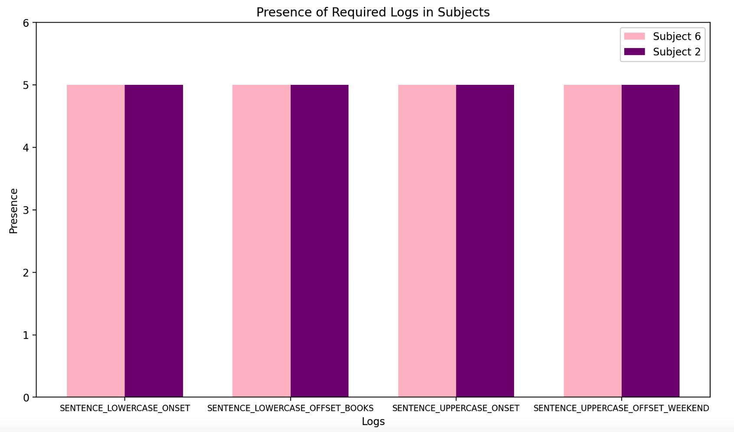
9
QUALITY CONTROL
To make sure the data we were collecting were good, we did some sanity checks with our first participants:
Checked all the logs were there
Plotted FPOGX and FPOGY (of the last row in each fixation ID)
Team Jaguar | 2024
Notes:
As part of our project, quality control was a crucial aspect to ensure the integrity and reliability of the data we collected.
we conducted sanity checks with our first participants and this step was essential in identifying any discrepancies or gaps in our data collection process, especially for what concerns the logs. We ensured that all logs were present and accounted for, which was a fundamental step for our analysis later on.

Slide 11
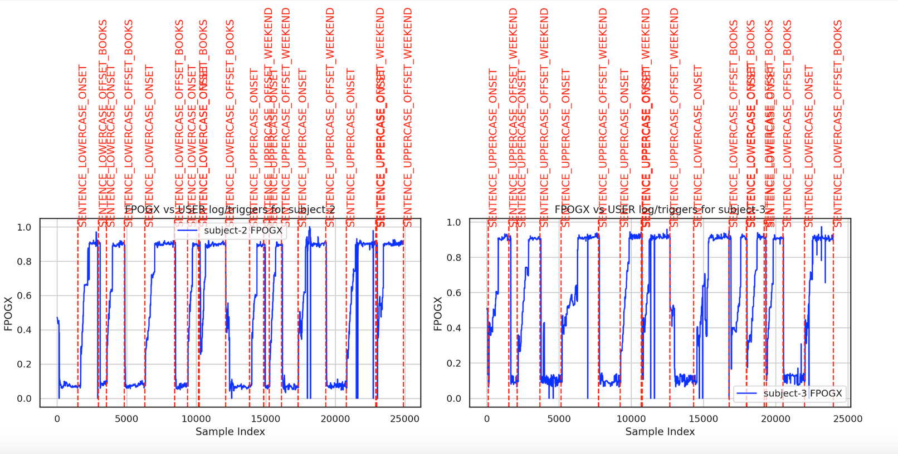
10
QUALITY CONTROL
A different plot to show the logs
Team Jaguar | 2024
Notes:
We considered it a good idea to include a second plot displaying all our logs for both subjects. This addition will also provide a clearer view of how the dialogues were randomised

Slide 12
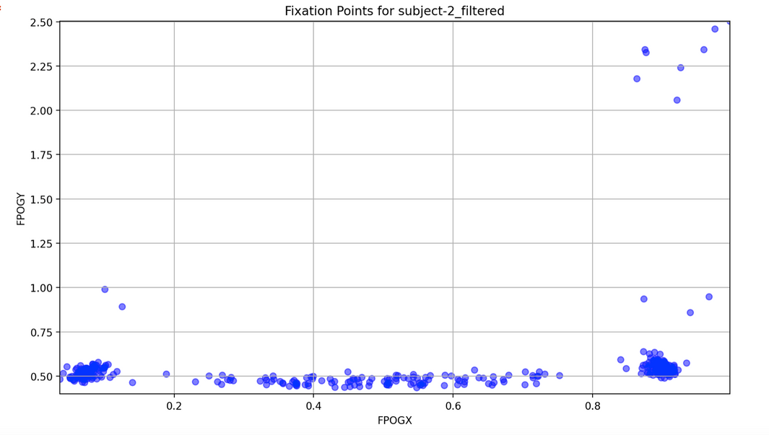
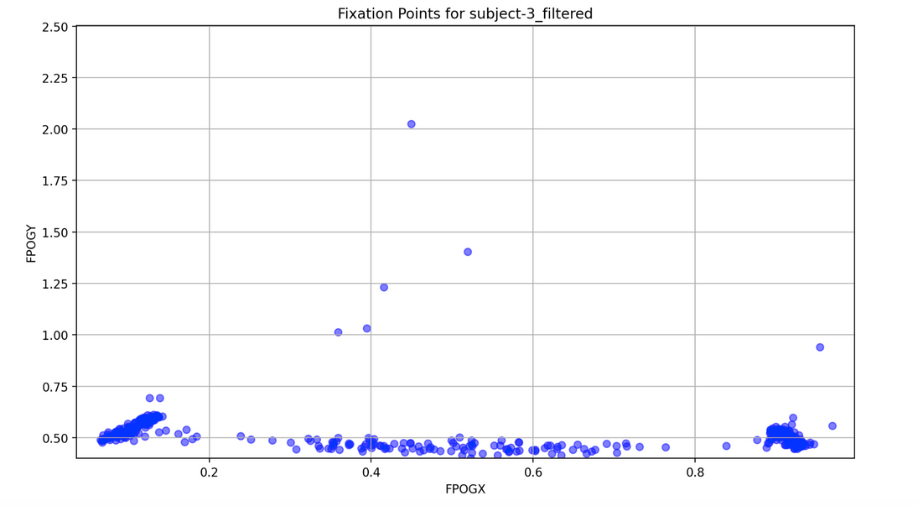
11
QUALITY CONTROL
FPOGX and FPOGY of 2 subjects
Team Jaguar | 2024
Notes:
Following this, we plotted the FPOGX and FPOGY coordinates for our subjects. This step involved mapping the gaze points to ensure they aligned with our expected outcomes. By examining the gaze direction data, particularly focusing on the last row in each fixation ID, we were also able to verify the coordinates but also about understanding the behaviour and patterns in the gaze data

Slide 13
12
OUR ANALYSES
How precisely is the analysis going to answer the research question?
Possible outcomes
We confirm the results in White & Liversedge (2006)
We prove that uppercase is in fact more difficult to read (Tinker and Paterson, 1939)
The analysis we’re going to use for our project are similar to the ones in the two previous studies
Team Jaguar | 2024
Notes:
"First, let's look at how our analysis will answer the research question. We are using methods similar to those in two previous studies. By doing this, we make sure our findings are accurate and reliable. These methods will help us see how eye movements differ when reading uppercase and lowercase text."
There are two main possibilities.
1. We might find the same results as White and Liversedge did in 2006. modern readers handle both cases equally well
Or, we might find that uppercase text is harder to read, evidenced by longer fixations and more regressions., just like Tinker and Paterson found in 1939.

Slide 14
13
REQUIRED ANALYSES
(to answer our research question)
Number of fixations
If one type case has more fixations than the other, it indicates that it requires more eye movements to be read.
Fixation Duration
The length of the fixation might be potentially due to the distinct character shapes in both case types.
Landing Spot
This suggests variations in initial fixation behavior, with different starting points for reading uppercase and lowercase text and could potentially affect readability.
Team Jaguar | 2024
Notes:
More fixations suggest that text case is harder to read.
Longer fixations might happen because of the different shapes of the characters in uppercase and lowercase text.
where the eyes first land when reading. Differences in landing spots between uppercase and lowercase text suggest variations in how we start reading each text type, which could affect readability.

Slide 15
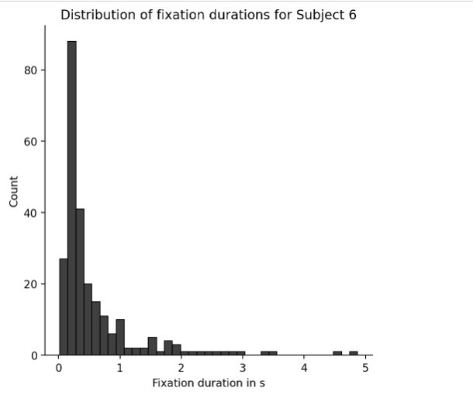
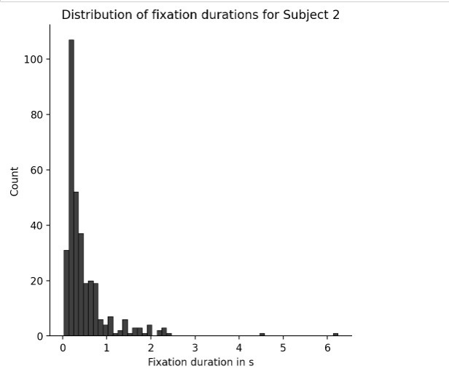
PILOT RESULTS
14
(fixation analyses for 2 subjects)
These plots display the TOTAL number of fixations and their durations for the two subjects.
As a preliminary step to better understand our data, we decided to plot the total number of fixations before plotting them for the two case types.
Team Jaguar | 2024
Notes:
- Here we have the results showing the fixation durations for two participants, subject 2 and subject 6. These graphs combine the data from both uppercase and lowercase text.
1. Distribution --- for subject 2 and 6, most of the fixation are under 1 second
2. Peak --- The highest count of fixations is at the shortest duration, around 0 to 0.5 seconds.
3. Longer Fixations --- There are some fewer fixations, up to 6 seconds for subject 2 and up to second 5 for subject 6, indicating occasional difficulty in processing certain parts of the text.
- Both subjects show a similar pattern: a high number of short fixations and fewer long fixations.
- This suggests that, overall, the text was readable for both participants.
- The presence of longer fixations indicates that certain parts of the text were more challenging and required extra attention.
Further analysis can separate uppercase and lowercase text to see if one was consistently harder than the other.

Slide 16
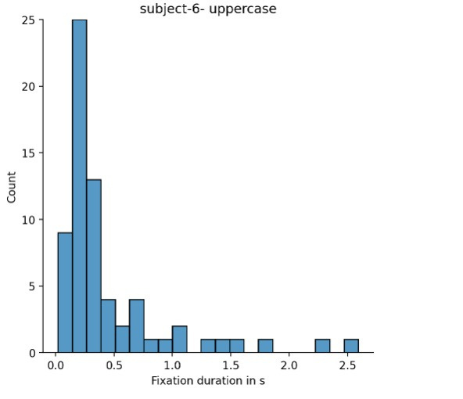
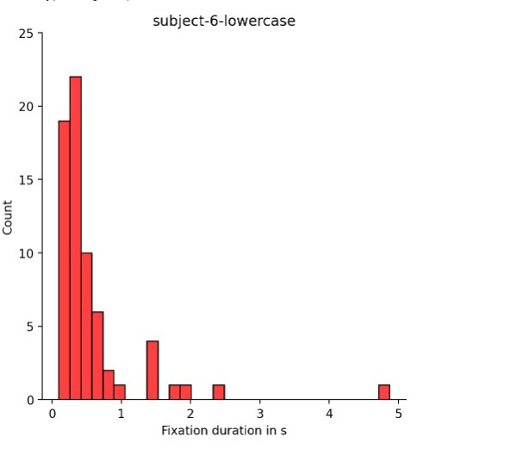
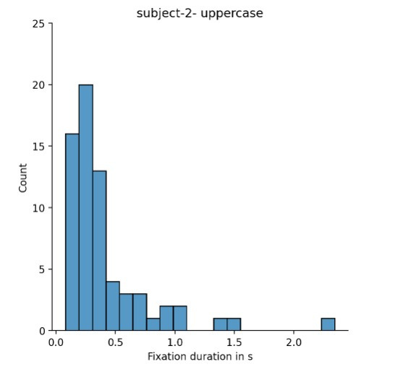
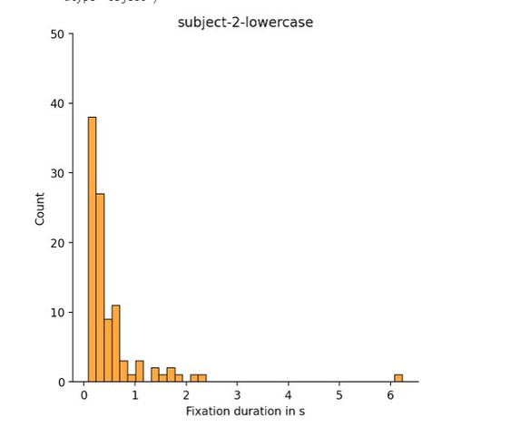
PILOT RESULTS
15
(fixation analyses for 2 subjects)
Fixation duration:
White & Liversedge (2006) = no difference in fixation duration
Tinker and Paterson (1939) = Average fixation durations were 20ms shorter for uppercase
Present experiment = slightly longer fixations for lowercase
Team Jaguar | 2024
Number of fixations:
White & Liversedge (2006) = no difference in number of fixations
Tinker and Paterson (1939) = 12% more fixations on UPPERCASE
Present experiment = no significant difference in number of fixations
Notes:
- Here we have the results of our experiment, showing the fixation durations for uppercase and lowercase text for two different participants, subject 2 and subject 6.
- The graphs on the left represent uppercase text, and the graphs on the right represent lowercase text.
Subject 6 Analysis
1. Uppercase (Top Left)
- Indicates that subject 6 mostly had short fixations with uppercase text.
2. Lowercase (Top Right)
- Most fixations are also under 1 second, but we see some fixations extending up to 5 seconds.
- This suggests more variability and possibly more difficulty with lowercase text compared to uppercase.
Subject 2 Analysis
1. Uppercase (Bottom Left)
- Indicates that uppercase text may be relatively easier for subject 2 to process quickly.
2. Lowercase (Bottom Right)
- Few longer fixations up to 6 seconds, indicating more difficulty with lowercase text.

Slide 17
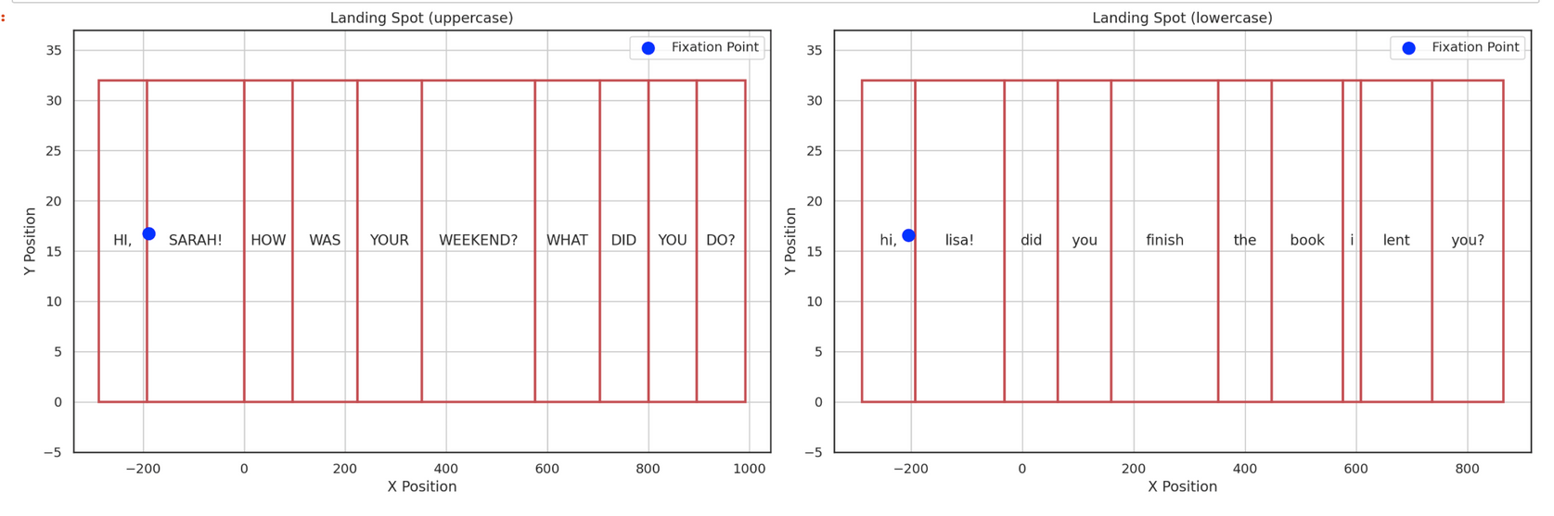
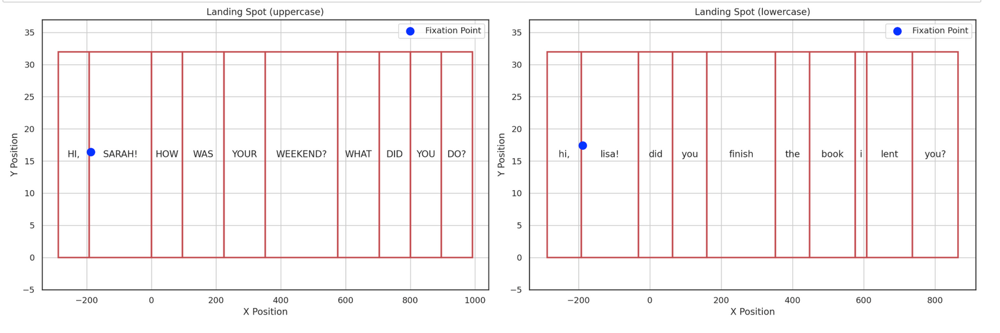
PILOT RESULTS
16
Landing spot:
White & Liversedge (2006) = landing spot was slighty closer to beginning of words for uppercase
Present experiment = no significant difference landing spot
Team Jaguar | 2024
Notes:
For this analysis, we relied solely on the 2006 study as the Tinker study did not provide relevant data for this specific type of analysis. According to the 2006 study, no significant differences were found between uppercase and lowercase letters in terms of landing spot. Our own data corroborates this finding, revealing no substantial distinctions.
Earlier plots indicated variability in landing spots, which we later attributed to one sentence being longer than the other. However, when comparing sentences of identical length, we observed no discernible differences in landing spots.
To generate these plots, we first calculated the width and length of each word, facilitated by our use of a monospaced font.
we then determined the bounding boxes for each word.
This methodology allowed us to demonstrate
conclusively that the case of letters-uppercase or lowercase-does not influence the landing spot on the screen.

Slide 18
17
CONCLUSIONS
Our findings thus far align more closely with the outcomes reported in White and Liversedge (2006).
Fixation duration ✅ (Our results so far indicate slightly longer fixations for lowercase text, but the difference is not statistically significant)
Landing spot ✅
Number of fixations ✅ (One subject showed slightly more fixations for the lowercase but overall there are no significant data)
Team Jaguar | 2024
Notes:
- For lowercase text, both subjects had longer fixations, suggesting it might be harder to read.
- The variability in fixation duration for lowercase text could indicate that participants are finding it more challenging and require more time to process.

Slide 19
Team Jaguar | 2024
THANK YOU
Sveva Battisti, Raheleh Soltani, Aishwarya Chaudhari

